Slide 1
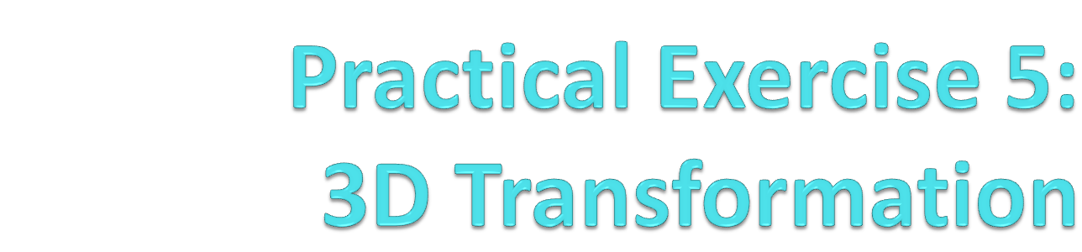
BACS 2173 Graphic Programming
[TOTAL : 30 marks]

Slide 2

Exercise Q1
Today, we go…

Slide 3
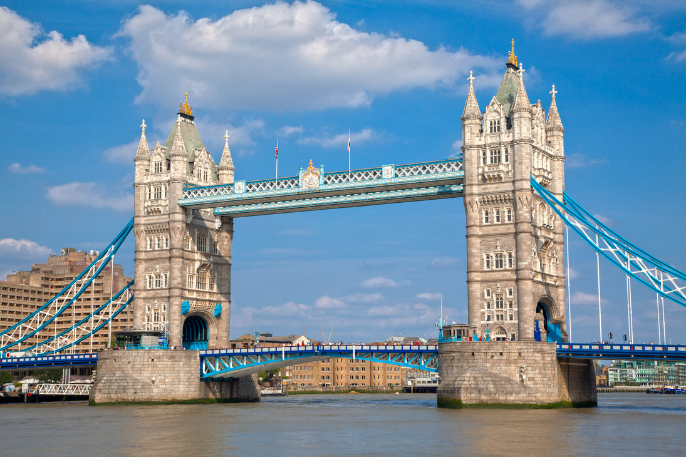
Exercise Q1
What famous in London?

Slide 4
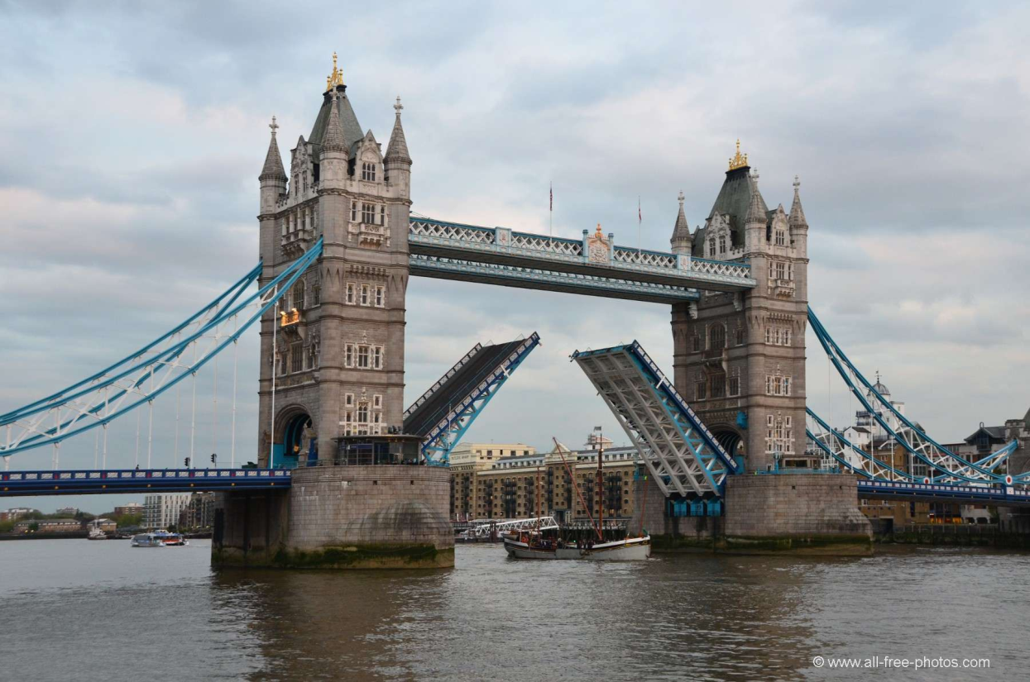
Exercise Q1
Tower Bridge

Slide 5
Exercise Q1
By using all the geometry primitives you have learned including 2D and 3D shapes, construct a London bridge.
Set up the camera and projection properly before you start to create the bridge. Try to use both projection and transformation for your viewport to view the bridge in a desire angle.
Perform transformation for the middle part of the bridge which should be able to open and close.

Slide 6
Exercise Q1
Criterias | Marks
Creativity | 2
Complexity of model (variety of primitives) | 16
Transformation (middle part) | 4
Type of Projection | 4
Viewport Transformation | 2
Extra features (background) | 2
TOTAL | 30

